Slide 1
Book Circle/Book Report by
Kendra Castelow & Aisha Evans
EDMG 6950/EDFS 6598
Spring 2014
GCSU

Slide 2
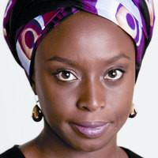
Chimamanda Ngozi Adichie
Nigerian-born author
Came to the United States at 19 years old
2011-2012 fellowship by the
Radcliffe Institute for Advanced Study,
Harvard University
Listed among the 'Ten Best Books of
2013', New York Times Book Review,
for Americanah http://www.l3.ulg.ac.be/adichie/cnabio.html

Slide 3
“Americanah”
Nigerian word
used to describe people who have been to the United States and return with American affections

Slide 4
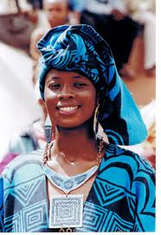
About the Book
Ifemelu
a Nigerian woman
recently completed a fellowship at Princeton
spent years in America creating noteworthy blogs about her American experience
decides to return to her home in Nigeria

Slide 5
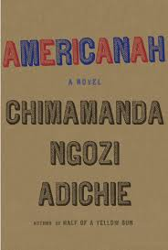
About the Book
Ifemelu’s Intriguing Story…
Her travels and experiences are cries for a place to belong
Notes:
We can share an experience about an ESOL student we’ve had who might have “cried” to belong.

Slide 6
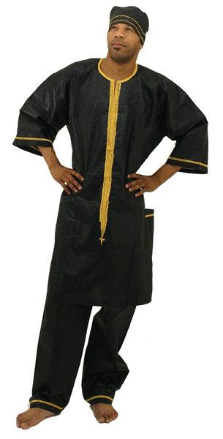
About the Book
Obinze
Ifemelu’s Nigerian teenage love
son of a professor
torn away from Ifemelu by war
hindered by post-9/11 America
now wealthy...and married

Slide 7
Americanah & ESOL Connection
addresses a lot of sentiments when it comes to what is average or acceptable for immigrants in America
body image and cultural expectations

Slide 8
Americanah & The Argument
You can’t have your cake and eat it too...or can you?
Beauty is more than skin deep.
That what you despise, you may become.
Assimilation is necessary to be “American.”

Slide 9
Thought-Provoking...
What does it take to make it in America?
How do WE experience America?
https://www.youtube.com/watch?v=0uW9AbMBoFM

Slide 10
Ifemelu’s Words...
“Of all their tribalisms, Americans are most uncomfortable with race. If you are having a conversation with an American, and you want to discuss something racial that you find interesting, and the American says, ‘Oh, it’s simplistic to say it’s race, racism is so complex,’ it means they just want you to shut up already.”

Slide 11
Other Key Points for Debate
Black Hair - Good vs. Bad
Religion - Respect for Others vs. Radicalism
Blackness in America - African vs. African-American

Slide 12
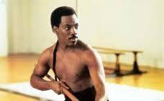
Black Hair and the Movies
What sort of impression can hair make?
What sort of hair is “attractive?”
Barber scene in “Coming to America”
Akeem and His Hair

Slide 13
Adichie on Importance of Ifemelu’s Hair...
"I like to say that this is a novel about love, about race, and about hair. In particular I want to talk about natural black hair, and how it's not just hair. I mean, I'm interested in hair in sort of a very aesthetic way, just the beauty of hair, but also in a political way: what it says, what it means” http://www.npr.org/2013/05/11/181685674/a-nigerian-americanah-novel-about-love-race-and-hair

Slide 14
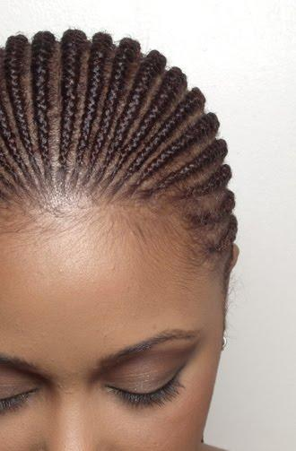
Adichie on Importance of Ifemelu’s Hair...
"[Ifemelu] is going for an interview and she's told that if she really wants to get the job — and she is qualified for the job — but she's advised that the best thing to do would be to take the braids out and get her hair straightened, because that's the way to look more 'professional.' "
http://www.npr.org/2013/05/11/181685674/a-nigerian-americanah-novel-about-love-race-and-hair

Slide 15
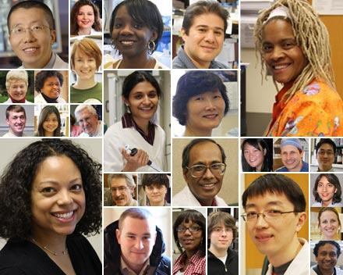
The Argument...
Being professional…
hair, clothes, and the external?
OR
personality, skills, and education?

Slide 16
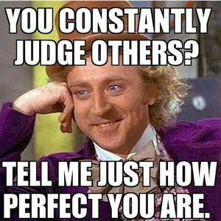
Question...
How have you been judged...
...by the way you look or what you wear?

Slide 17
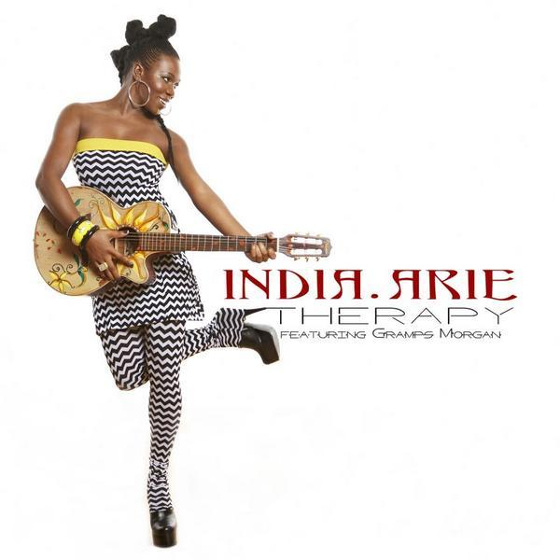
Hair and Music
relevant in our classrooms
India.Arie (African-American musician)
I Am Not My Hair
Notes:
We can stop it at around 2 min

Slide 18
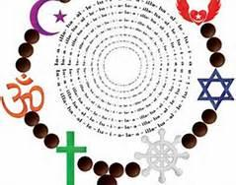
Religion - Respect for Others vs. Radicalism
Adichie comments...On the influence of Christianity and education in contemporary Africa
"[M]issionaries brought education, so that it wasn't just education, it was religion: They both came hand-in-hand. So that for my father, for example, who was born in 1932 and who started to go to school in eastern Nigeria in 1936, you didn't just go to learn math, and English and science, you also learned that Jesus was Lord and everything your parents were doing at home was evil and demonic and all of that. And so now we have a generation of educated Africans who are also very Christianized.
http://www.npr.org/2013/06/27/195598496/americanah-author-explains-learning-to-be-black-in-the-u-s

Slide 19
Religion - Respect for Others vs. Radicalism
Adichie further comments...On the influence of Christianity and education in contemporary Africa
“[And] not only Christianized, because I think it's possible to be Christianized and still have a respect for other traditions, but many of them don't because their version of Christianity — their God — was one in which to be Christian meant to not only reject, but demonize, traditional religion. So many people in my father's generation think that what their fathers and grandfathers and great-grandfathers did was evil, or they use interesting words like heathen and pagan."
http://www.npr.org/2013/06/27/195598496/americanah-author-explains-learning-to-be-black-in-the-u-s

Slide 20
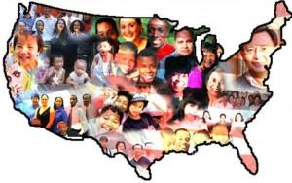
Assimilation is necessary to be “American.”
Is being an “American” being “Christian?”
If it is, what about the other Muslims, Buddhists, Hindus, and others who’ve made America their home…?
Being respectful and being radical...what message is in both?
Do inhabitants here in America feel celebrated...or tolerated?
Notes:
We can share an instance when our ESOL student took issue with religion in America (i.e. Muslims and fasting vs. lunchtime during Ramadan, Jehovah Witness and holidays, etc.)

Slide 21
Blackness in America -
African vs. African-American
The history of the trans-Atlantic slave trade was not taught to students in Nigeria.
"Race is such a strange construct," says Adichie, "because you have to learn what it means to be black in America.”
http://www.npr.org/2013/06/27/195598496/americanah-author-explains-learning-to-be-black-in-the-u-s

Slide 22
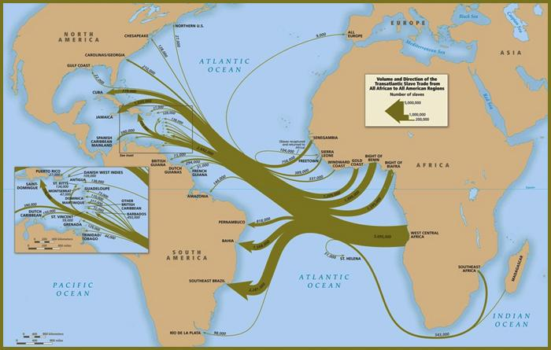
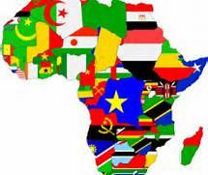
What is “being black” in America?
homeland
multilingual, including “mother tongue”
hair - extensions, weaves, ponytails
skin color
Global Diaspora Summit
2012

Slide 23
What you despise, you may become.
Ifemelu fought to remain true to her homeland while being an American.
Venues: University, African hair salons, Churches and other religious institutions
Ifemelu acknowledged that her existence is her heart...and not her “home.”

Slide 24
An International Symbol
unity...interconnected...of the nations

Slide 25
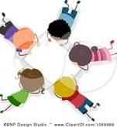
Argument Activity
Consider the arguments that this novel presents and in groups of 4 or 5, create an acrostic for your assigned word.
Group 1 - Assimilation
Group 2 - Immigrant
Group 3 - Cultural
Group 4 - Americanah

Slide 26
Book Circle/Book Report by
Kendra Castelow & Aisha Evans
EDMG 6950/EDFS 6598
Spring 2014
GCSU

